Slide 1
PERIODIC CLASSIFICATION OF ELEMENTS
CONTENTS:
What is Periodic table
Need for classification of elements
Dobereiner’s Triads
Newland’s Law of Octaves
Mendeleev’s Periodic Table
Modern Periodic Table
Trends in Modern Periodic Table

Slide 2
WHAT IS A PERIODIC TABLE
It is the tabular display of elements organized on the basis of atomic number, electronic configurations and chemical properties.
The table also shows four rectangular blocks: s-, p- d- and f-block. In general, within one row (period) the elements are metals on the left hand side, and non-metals on the right hand side.
The rows of the table are called periods; the columns are called groups

Slide 3
NEED FOR CLASSIFICATION OF ELEMENTS
In the year 1800, only 30 elements were known. Now, at present, there are 118 elements known.
So, it became difficult for the scientist to remember all the properties of elements.
Therefore, there was a need to classify elements.
Many scientist tried to classify elements based on different criteria. Some brought success while some did not.

Slide 5
ORGANIZING THE ELEMENTS
• Chemists used the properties of
elements to sort them into groups.
• JW. Dobreiner grouped elements into
triads.
• A triad is a set of three elements with
similar properties

Slide 7
Dobereiner’s Triads
Dobereiner classified elements in the increasing order of their atomic masses into groups of three elements called triads. In each triad the atomic mass of the middle element was approximately equal to the average atomic mass of the other two elements.
The defect in this classification was that all the then
known elements could not be correctly arranged into
triads.

Slide 8
Example of Dobereiner’s Triad:
Element Atomic mass
Lithium: 7amu
Sodium: 23amu Potassium: 39amu
So, this is one example of his triad. In this triad atomic mass of sodium is average of the other two atomic mass.
i.e. 7+39/2 = 46/2 = 23amu.
Limitation of his Triad:
Dobereiner could only find three such triads from the elements known at that time. Thus this system of classification was not found to be useful.

Slide 10
Newland arranged element according to their increasing atomic mass.
He found out that every eight element had properties similar to first. This came to be known as Newlands’ law of octave.
Example:
Lithium and Sodium were found to be same.

Slide 12
Limitations:
Law of octave was only applicable up to calcium as after every eight element did not have same properties to that of first.
He assumed that only 56 element existed and no more elements were to be discovered.
In order to fit elements into the table, Newlands’ adjusted two elements like cobalt
and nickel in the same slot and also put some unlike elements under the same note.
So this law only worked well with lighter elements hence it was not applicable with elements have atomic mass above 40u

Slide 14
He arranged elements on the bases of Atomic mass
and chemical properties.
He selected hydrogen and oxygen and reacted every elements with it and formed its compounds.
Compounds of hydrides and oxides were treated as one of the basic properties of an element for its classification.
He formulated Periodic Law:
Properties of elements are the periodic function of
their atomic mass.

Slide 16
Achievements of Mendeleev
Predicted existence of some elements that were not discovered at that time. Eg: Gallium, Scandium and Germanium.
Predict properties of elements on basis of its position.
Nobel gases which were discovered later could fit in his table.

Slide 17
LIMITATIONS OF MENDELEEV’S TABLE
Position of the Isotopes could not be explained.
Wrong order of atomic mass could not be explained in some case. Eg: Cobalt(58.9) came before Nickle(58.7).
Hydrogen was not assigned correct position. It had properties of both alkali and Halogens.

Slide 19
In 1913 Henry Moseley showed that atomic number of an element was more fundamental property than atomic mass.
Modern periodic law:
Properties of elements are the periodic function of their atomic number.

Slide 20
Modern periodic table consists of 18 groups and 7 periods.
Through the modern periodic table:
Position of isotope is clear.
Position of Nickle and cobalt is clear.
Position of hydrogen is well explained.

Slide 22
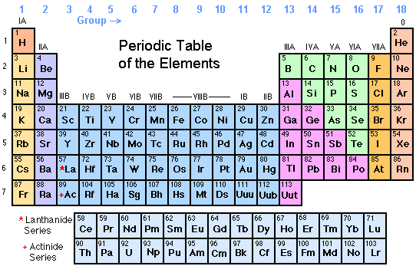

Slide 23
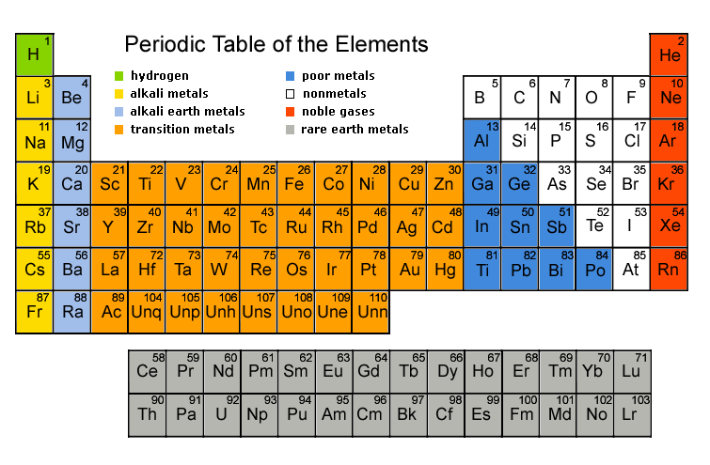

Slide 24
Trends in Periods
Period – Horizontal rows of element in a periodic table are called periods.
Trends :-
Valence electron : From left to right number of valence electron increases.
Atomic Number : From left to right there is consecutive atomic number.
Valency : From left to right Valency increases from
1 to 4 and then decrease to 0.
Atomic size : Decreases from left to right.
Metallic Character : Metallic character decreases from left to right.
Chemical reactivity : From left to right, decreases then increases.
Nature of oxides : From left to right basic character decreases and then acidic character increases.

Slide 25
Trends in Groups
Group – Vertical columns in periodic table is known as
groups.
Trends :-
Valence Electron : Have same number of valence electron.
Valency : Elements in a group have a same Valency.
Atomic size : Increases from up to down.
Metallic Character : On going down metallic character increases.
Chemical Reactivity : On going down chemical reactivity
of metal increases but chemical reactivity of non metal
decreases.
Nature of oxides : All elements in group has same nature of oxides.

